Slide 1
SharePoint Security and Claims-based Authorization
Notes:
Lecture 14: SharePoint Security - 1

Slide 2
Outline
SharePoint Security Fundamentals
Introduction to Claims-based Security
Configuring Claims-based Security
Development Opportunities

Slide 3
Security 101
Authentication and Identity
Authentication creates identity for security principal
Identities stored in user accounts repository
Authentication performed using credentials
Authentication produces some form of badge
Authorization and Access Control
Subsystem used to define security policy
Privileged users configure ACLs on objects
Subsystem enforces policy at run time
Notes:
Lecture 14: SharePoint Security - 3

Slide 4
SharePoint 2007 Authentication
SharePoint relies on external components
Windows Authentication via Windows Server and IIS
FBA via ASP.NET and authentication provider
Web SSO via Active Directory Federation Services (ADFS)
SharePoint creates profile for external identity
Tracked per site collection in User Profile List
Seen by developers as SPUser object
Notes:
Lecture 14: SharePoint Security - 4

Slide 5
SHAREPOINT\System Account
WSS V2 has issues with AppPool Identity
WSS V3 introduced SHAREPOINT\system
Hides IIS Application Pool Identity from users
Runs as God within WSS authorization system
Removes need to treat Application Pool Identity as site user
Notes:
Lecture 14: SharePoint Security - 5

Slide 6
WSS Identity vs. Windows Identity
It’s important to understand the difference
Web Server
Pages, Lists & Documents
SharePoint content
Web Application Worker Process
Authorized using SharePoint Identity
Authorized using Windows Identity
AdventureWorks Database
SQL Server
XML File
local file system
Notes:
Lecture 14: SharePoint Security - 6

Slide 7
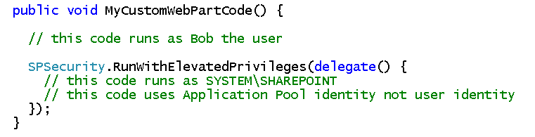
Elevation of Privledges
Code typically runs under identity of user
Authorization works as expected in SharePoint
Sometime code must do things current user cannot do
Custom code elevate privilege
Advantage: elevated code can do anything
Disadvantage: elevated code can do anything
Notes:
Lecture 14: SharePoint Security - 7

Slide 8
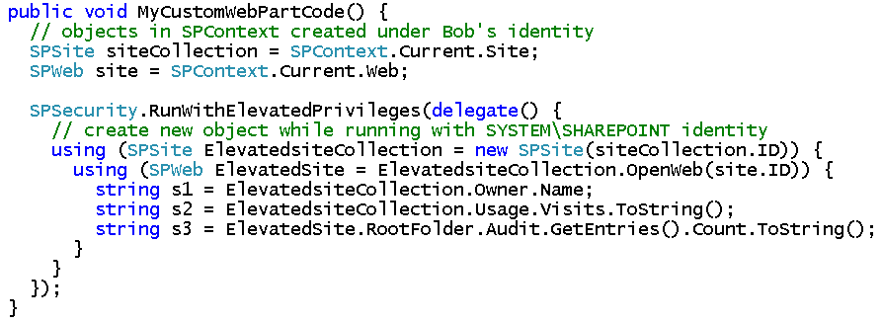
SPSite and Elevated Privileges
Accessing sites with WSS object is tricky
Must create new SPSite object after elevating
Notes:
Lecture 14: SharePoint Security - 8

Slide 9
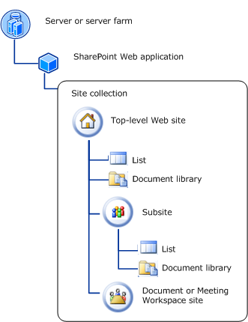
Securable Objects
Each site collection is a hierarchy
Each object may have its own ACL
Object without ACL relies on parent
Top-level site is top-level object in hierarchy
Notes:
Lecture 14: SharePoint Security - 9

Slide 10



Securable Objects OM
SPUser represents external security principal
SPGroup is internal SharePoint group
N
SP User
N
N
SP Group
Rights
N
N
1
N
Role Definition
1
N
Role Assignment
N
AuthZ
Resource
SP User
Notes:
Lecture 14: SharePoint Security - 10

Slide 11
Outline
SharePoint Security Fundamentals
Introduction to Claims-based Security
Configuring Claims-based Security
Development Opportunities

Slide 12
SharePoint 2010 Security
SharePoint 2010 radically changes authentication
WSS moves to claim-based security model
SharePoint 12 style now considered legacy mode
Why?
It decouples WSS from authentication provider
Supports multiple authentication providers for one URL
Identity can be passed without Kerberos delegation
It enables federation between organizations
ACLs configured with DLs, Audiences and Orgs
PeoplePicker controls understands claims
Notes:
Lecture 14: SharePoint Security - 12

Slide 13
Claim-based Terminology
Identity: security principal used to configure security policy
Claim: attribute of an identity (Login Name, AD Group, etc)
Issuer: trusted party that creates claims
Security Token: serialized set of claims in digitally signed by issuing authority (Windows security token or SAML)
Issuing Authority: issues security tokens knowing claims desired by target application
Security Token Service (STS): builds, signs and issues security tokens
Relying Party: application that makes authorization decisions based on claims
Notes:
Lecture 14: SharePoint Security - 13

Slide 14
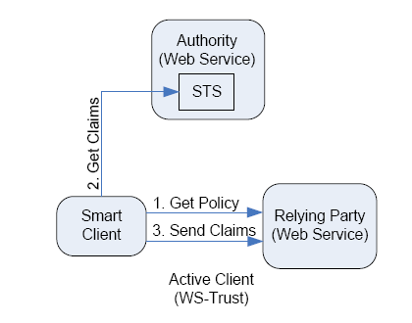
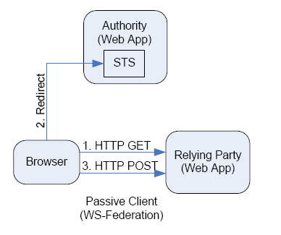
Claims-based Scenarios
Active Client - Smart Client App
Passive Client - Browser
Notes:
Lecture 14: SharePoint Security - 14

Slide 15
Claims in SharePoint 2010
Two important scenarios
Incoming claims
Outgoing claims
How do incoming claims work?
Identity token created by external identity STS
SharePoint STS creates claim-based identity
SharePoint STS based on Claims Provider
Incoming claim identity is mapped to SPUser
Authorization of SPUser just like it is in SharePoint 2007
Notes:
Lecture 14: SharePoint Security - 15

Slide 16
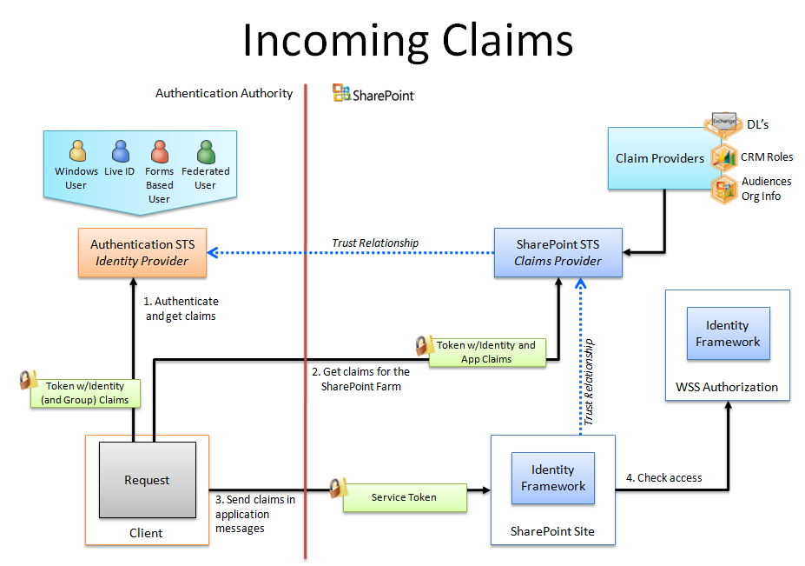
Notes:
Lecture 14: SharePoint Security - 16

Slide 17
Outgoing Claims
What identity is used for code on WFE?
By default, code has claims-based identity
Legacy mode can be used for Windows identity
What are the scenarios?
WFE code calls to application services
WFE code calls to external LOB systems
WFE code calls to external SharePoint farms
Notes:
Lecture 14: SharePoint Security - 17

Slide 18
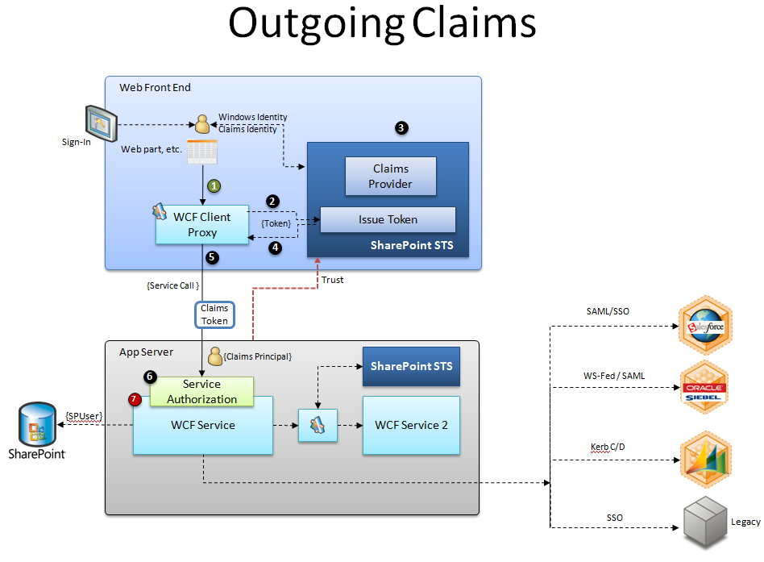

Notes:
Lecture 14: SharePoint Security - 18

Slide 19
Outline
SharePoint Security Fundamentals
Introduction to Claims-based Security
Configuring Claims-based Security
Development Opportunities

Slide 20
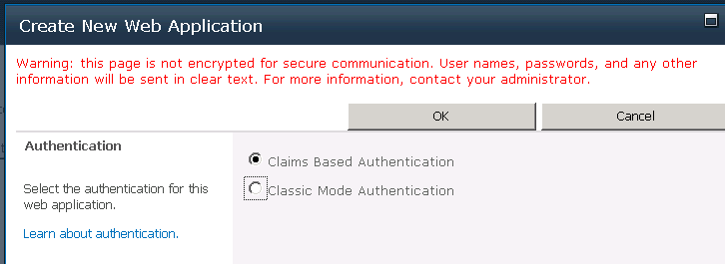
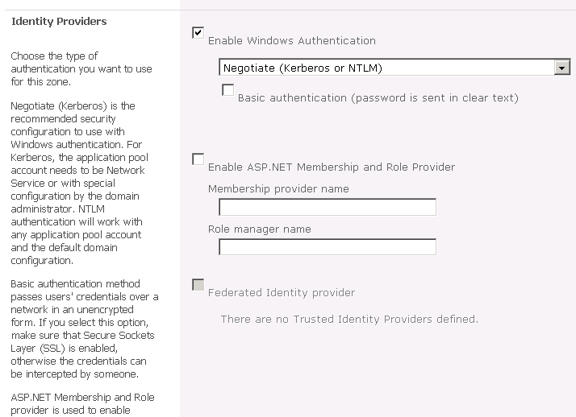
Admin UX (Configure AuthN)
Notes:
Lecture 14: SharePoint Security - 20

Slide 21
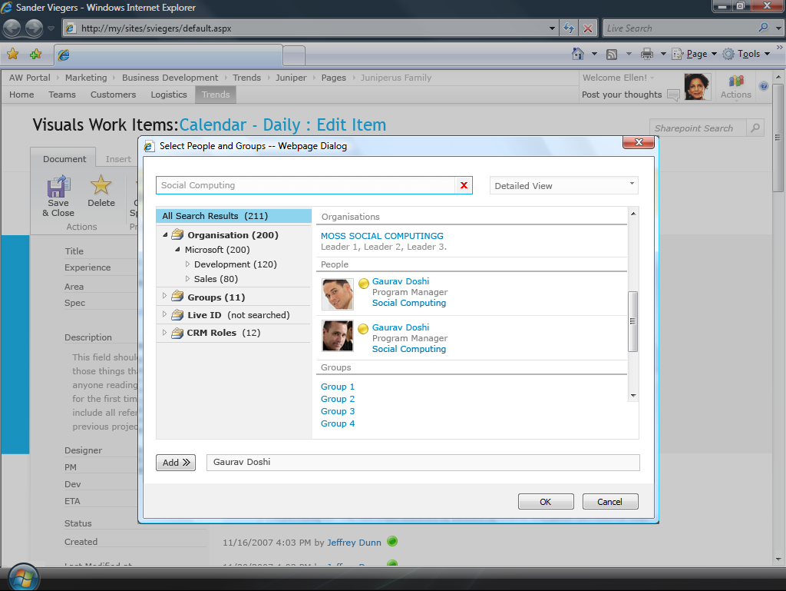
Notes:
Lecture 14: SharePoint Security - 21

Slide 22
Outline
SharePoint Security Fundamentals
Introduction to Claims-based Security
Configuring Claims-based Security
Development Opportunities

Slide 23





Securable Objects OM
AD Security Group
DL
Audiences
Org
App claims
Roles
Claims
Contoso User (Federated user)
Live ID
FBA User
Windows User
Principals
Assign
N
SP User
N
N
SP Group
Rights
N
N
1
N
Role Definition
1
N
Role Assignment
N
AuthZ
Resource
SP User
Notes:
Lecture 14: SharePoint Security - 23

Slide 24
Development Opportunities
Same as in SharePoint 2007
Write code that creates groups
Write code that assigns permissions
New to SharePoint 2010
Create a custom claims-provider
Create an identity transformation service with Geneva Server

Slide 25
Summary
SharePoint Security Fundamentals
Introduction to Claims-based Security
Configuring Claims-based Security
Development Opportunities

